Slide 1

SWEN20003 Workshop
  Week 04
Demonstrator: Xulin Yang

Slide 2

Workshop tasks
Note: If you don’t master this workshop contents, hope for the best for your project …
Make sure you are using java 11
Show how to clone repo in IntelliJ
Show how to commit & push in IntelliJ (add bagelTest to repo)
Mark source & resource root
Import bagel through maven
Run bagelTest.java

Slide 3
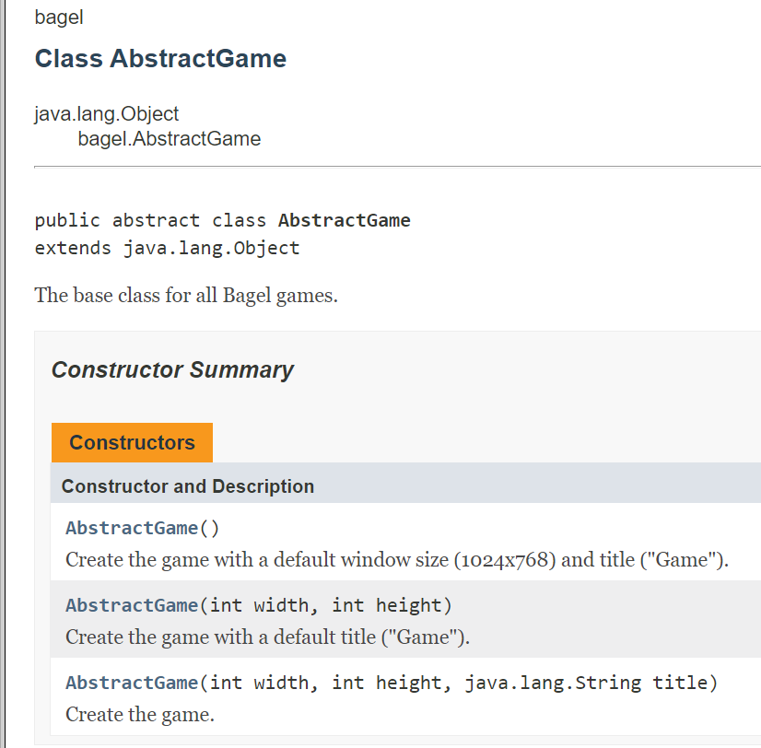
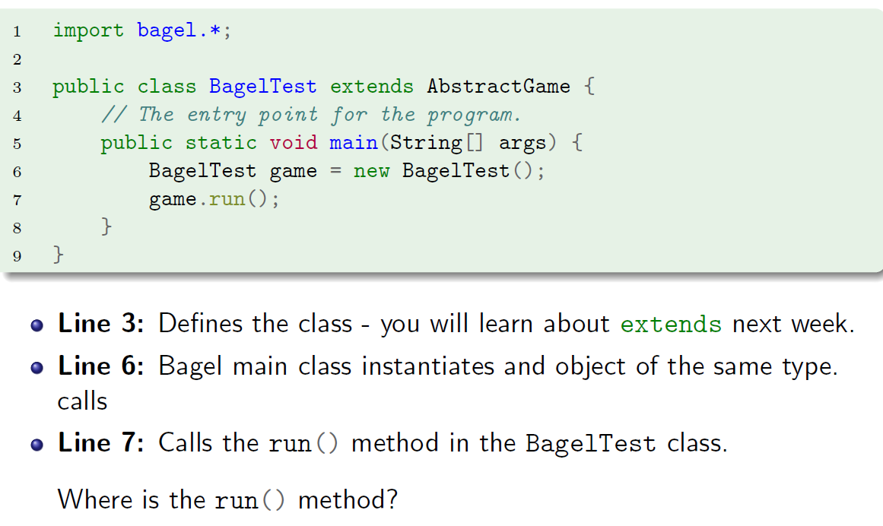
Workshop Q3
Previously we have Main class for public static void main(String[] args) method
The AbstractGame class work as an entry point for your game (you need to extend it)
Notes:
https://people.eng.unimelb.edu.au/mcmurtrye/bagel-doc/

Slide 4
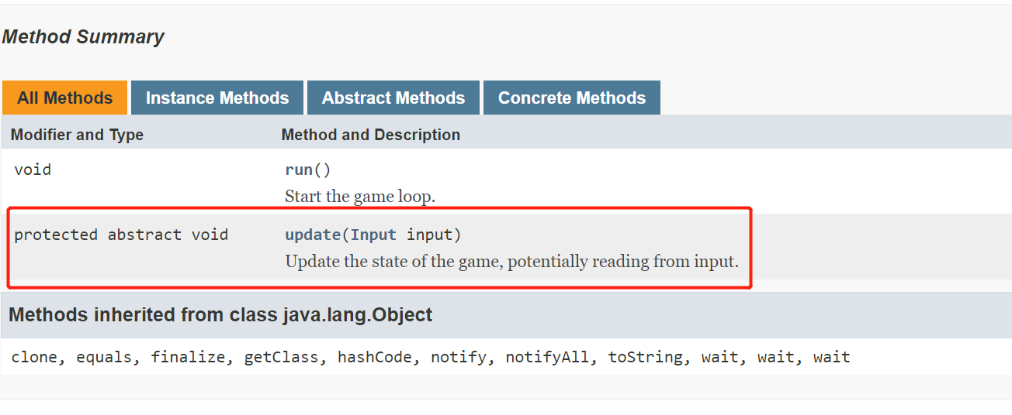
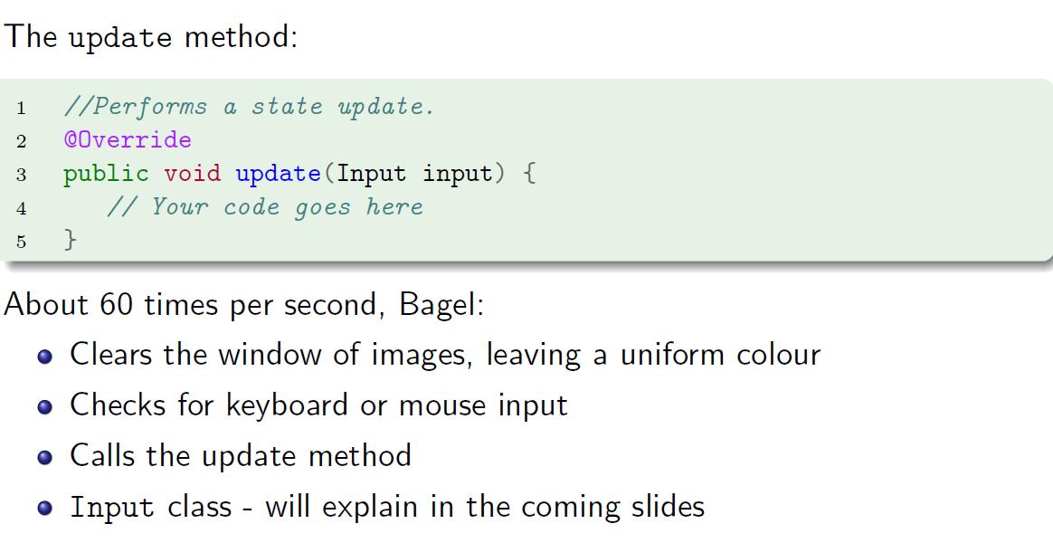
Workshop Q3
As AbstractGame has abstract method update(Input input)
You need to implement it (@Override)

Slide 5
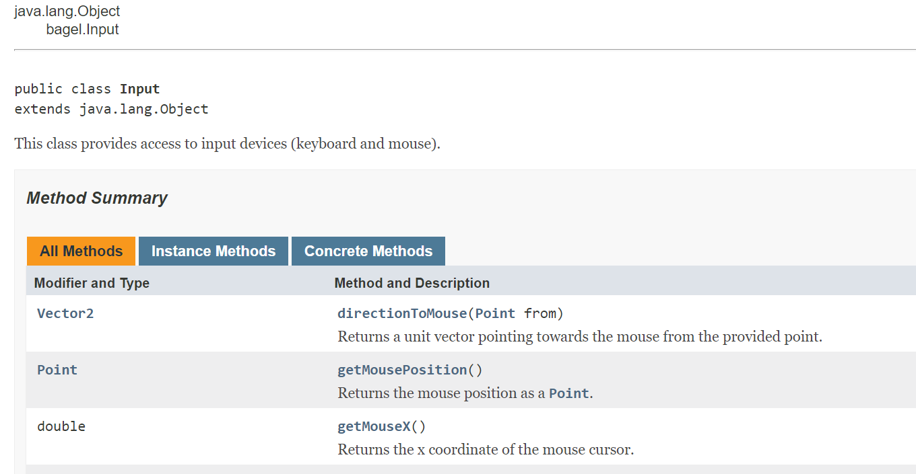
Workshop Q3
The Input class contains the keyboard, mouse action you want to abstract and updates the entities in the game based on the interaction with the user.

